Slide 1

Applications of Data Structures
CSC 143 Brian Cui

Slide 2

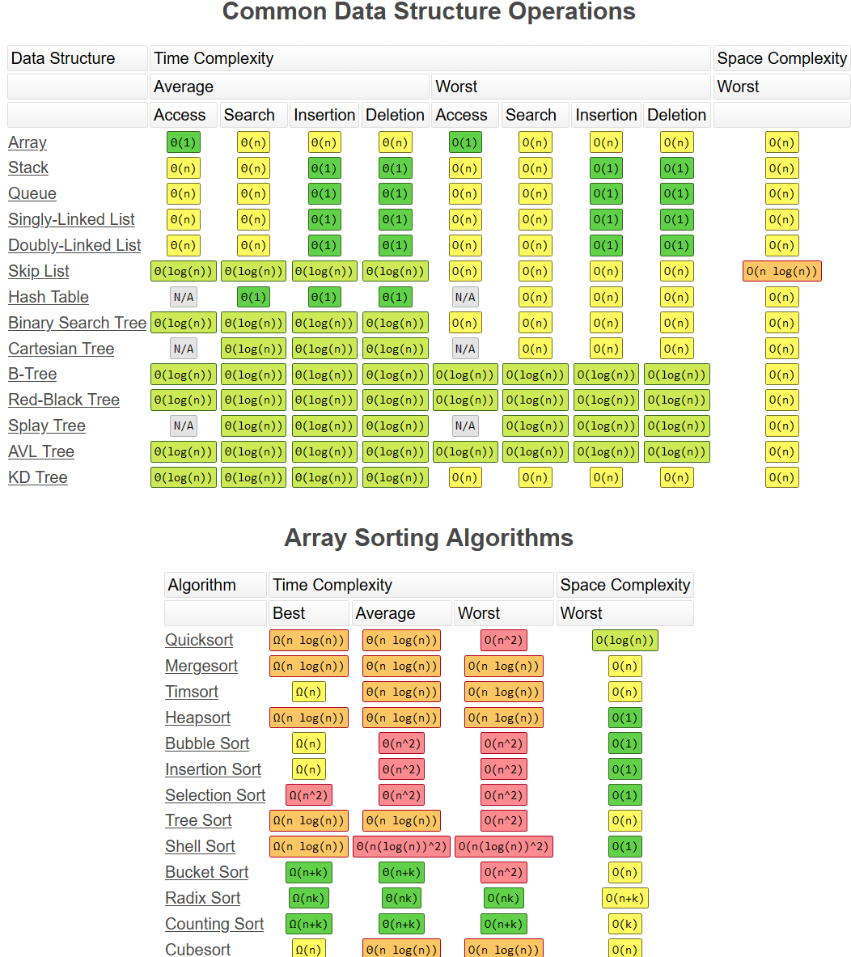

The Best Data Structure?
Array (+ArrayList)
Linked List (+Doubly, Stack, Queue)
Tree (+Binary, BST)
Heap (+Priority Queue)
HashMap
Graph
bigocheatsheet.com

Slide 3
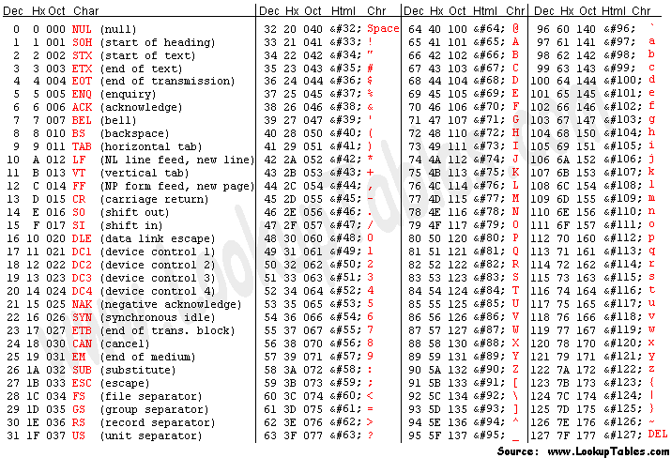
Humble Beginnings
// C (1973 – 2018+) char[] mybuff = "Hello";
0 | 1 | 2 | 3 | 4 | 5
'H' | 'e' | 'l' | 'l' | 'o' | '\0'
Before there were Strings, there were char arrays.
Extremely efficient, zero overhead

Slide 4
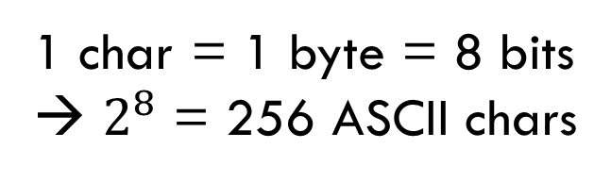
0 | 1 | 2 | 3 | 4 | 5
'H' | 'e' | 'l' | 'l' | 'o' | '\0'
1 char = 1 byte = 8 bits
→ $2^{8}$ = 256 ASCII chars
"Null Terminator" char indicates end of string

Slide 5
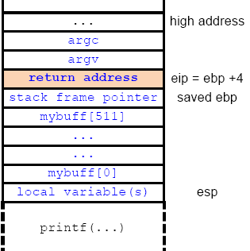
0 | 1 | 2 | 3 | 4 | 5
'H' | 'e' | 'l' | 'l' | 'o' | '\0'
1 char = 1 byte = 8 bits
→ $2^{8}$ = 256 ASCII chars
Raw Pointers are Dangerous!
Memory outside of String buffer is unprotected
Read/Write access
Off-by-one errors overwrite important memory

Slide 6
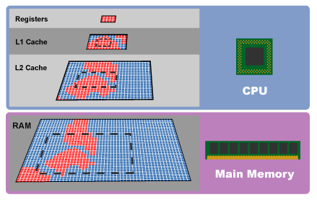
RAM + Cache Memory Layout
Arrays are fast.
Arrays sacrifice complexity for speed. Indexing is always O(1).
A significant contributor for array speed is caching.
0 | 1 | 2 | 3 | 4 | 5
'H' | 'e' | 'l' | 'l' | 'o' | '\0'

Slide 7
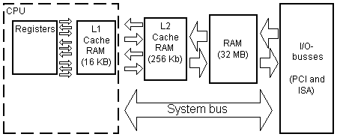
Speed vs. Storage
Physics (surface area) means smaller is faster
Layers of caches balance speed and size
Contiguous data (arrays) are easy to cache

Slide 8
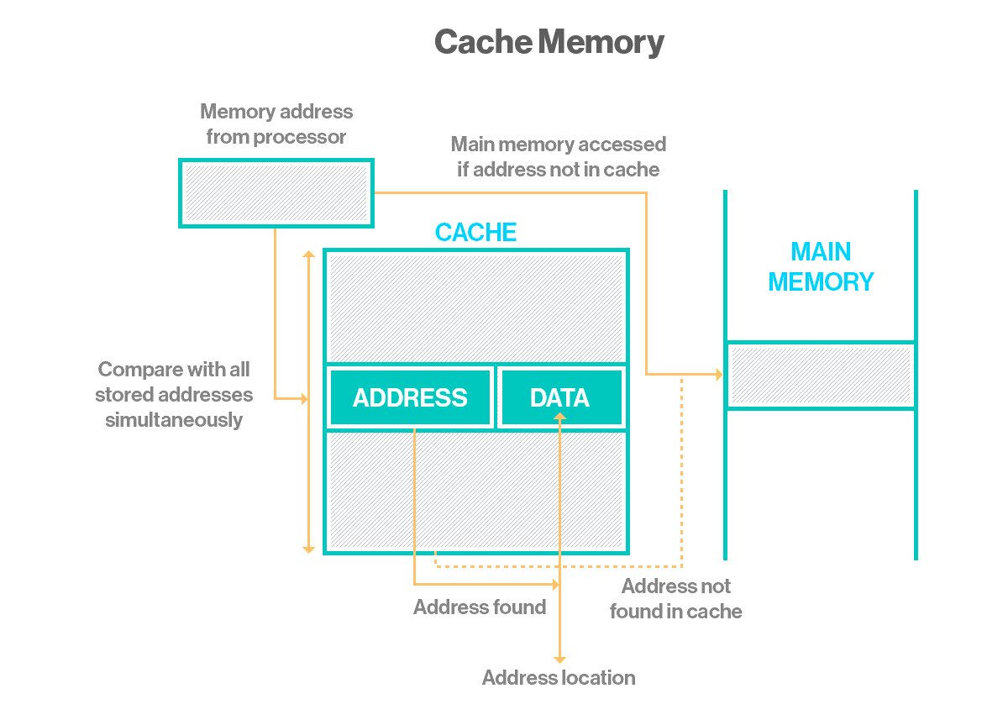
Caching: The Big Idea
mybuff[2]
mybuff[2]
As memory is read, copy large nearby contiguous blocks at once into cache.
Arrays are by nature contiguous and therefore very cache friendly!
Cache several nearby bytes simultaneously on read

Slide 9
Caching: The Big Idea
mybuff[2]
mybuff[3]
mybuff[2]
As memory is read, copy large nearby contiguous blocks at once into cache.
Arrays are by nature contiguous and therefore very cache friendly!
mybuff[1]
mybuff[0]
Nearby array indices are readily available in cache

Slide 10
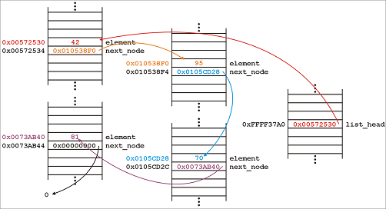
Caching + Linked List: Not So Fast
Linked List nodes can be stored physically far apart and are harder to cache

Slide 11
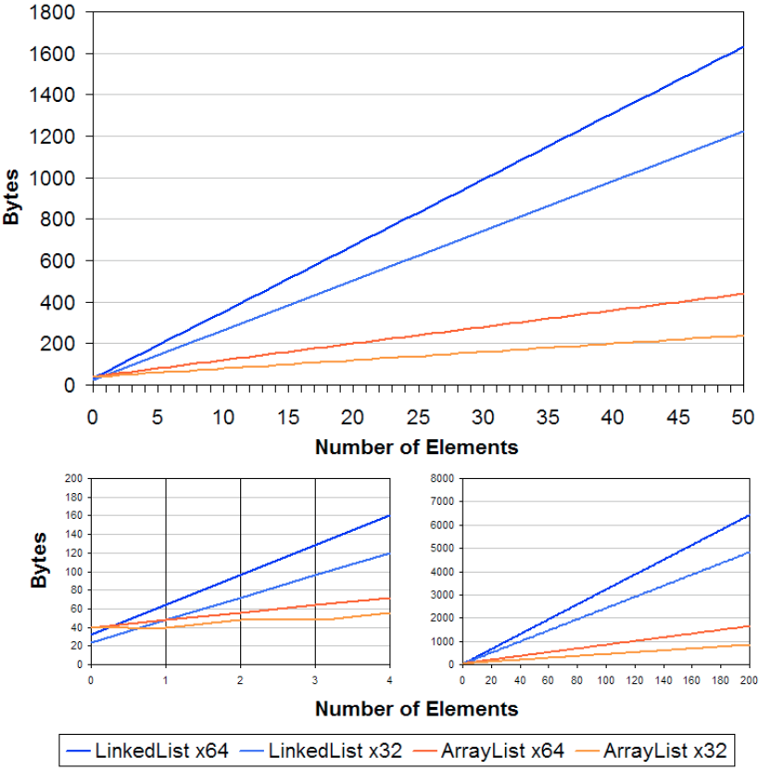

Linked List Considered Harmful?
Linked Lists are not only cache-unfriendly, but they incur overhead:
Object overhead: header for every node contains references to class + methods
Allocation overhead: every insertion requires scanning the Heap for free space
Source: StackOverflow LinkedList vs. ArrayList Reading

Slide 12
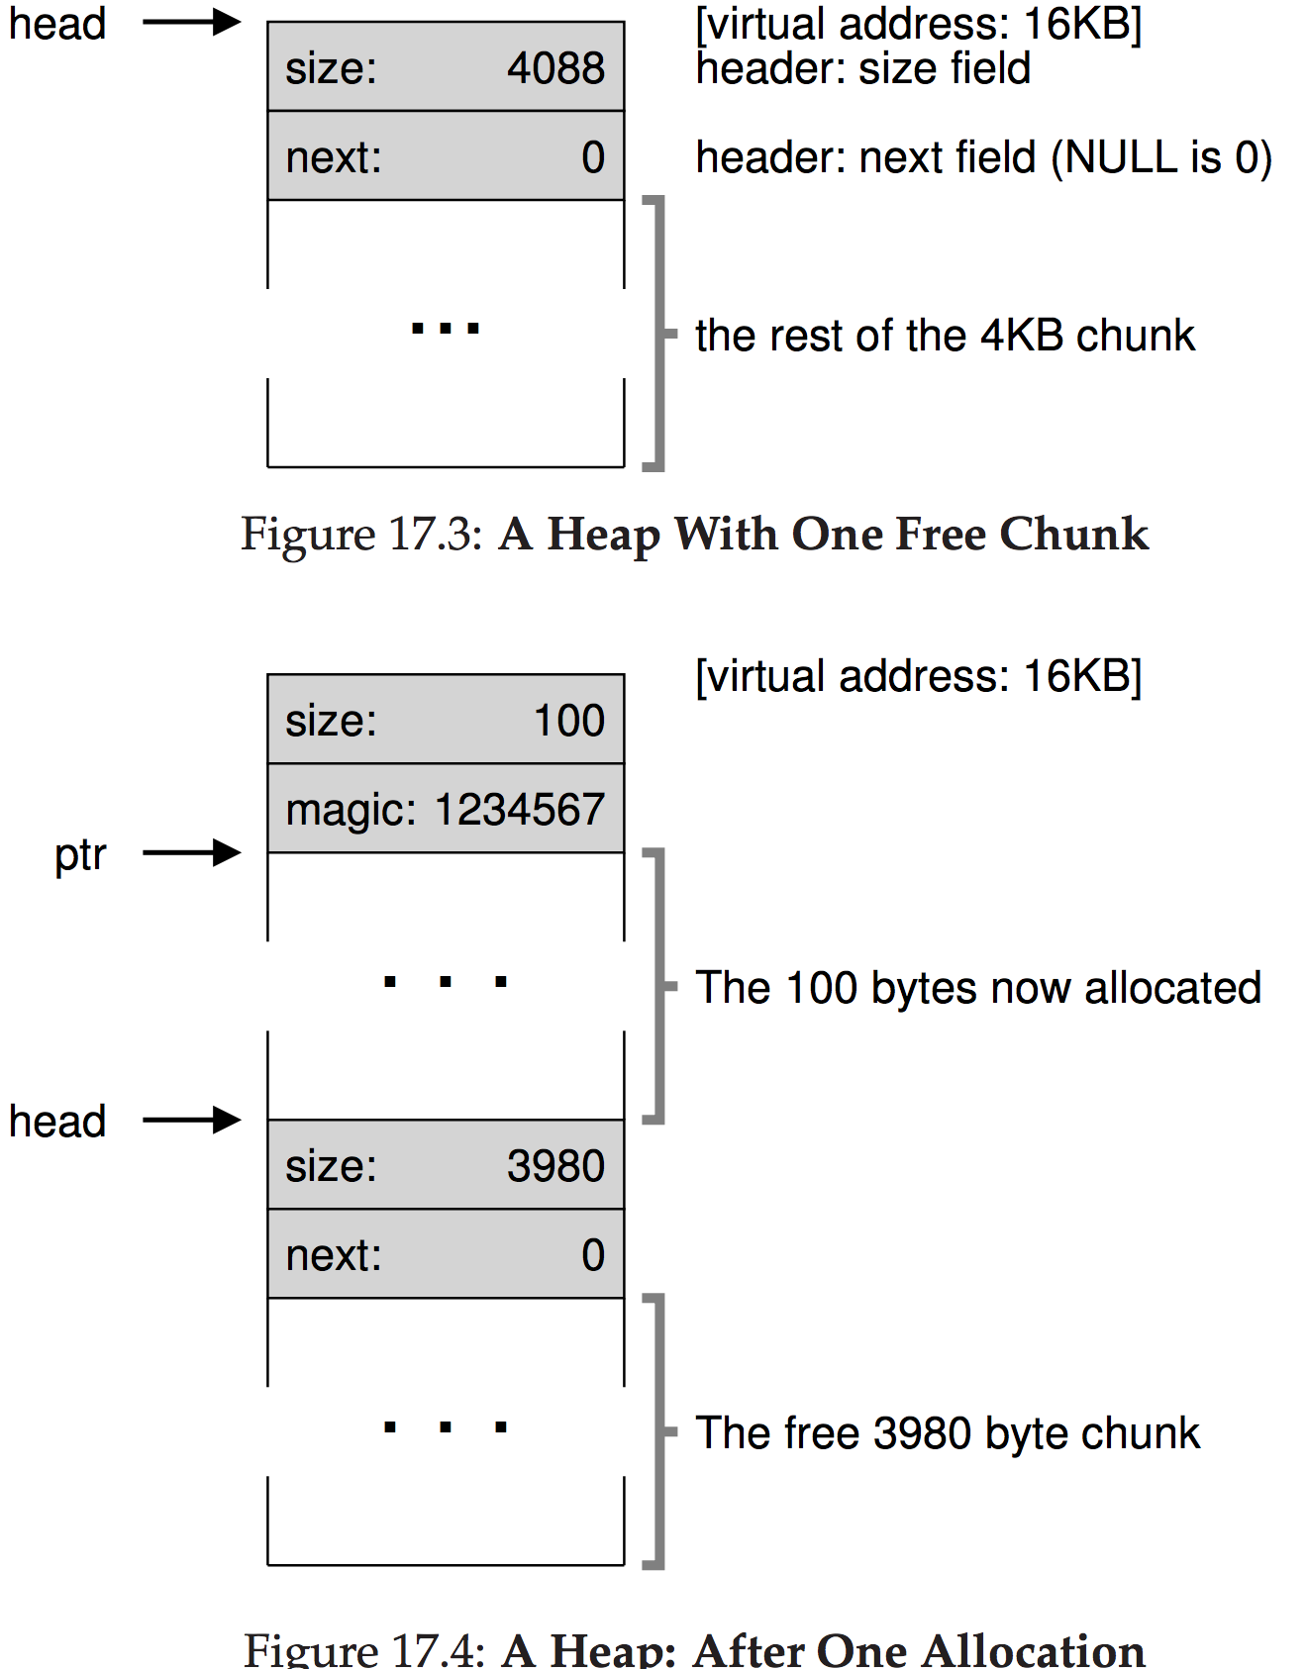
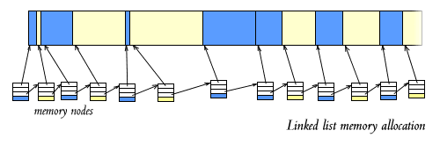
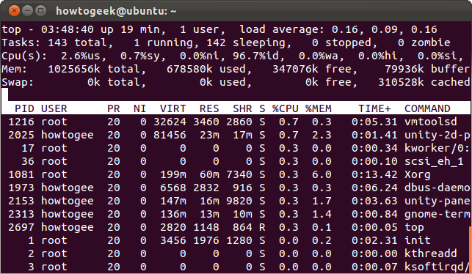
Linked Lists in the OS
Linked Lists are excellent for connecting a sequence of objects that are by nature separately stored.
O(1) in-place insertion and deletion with no copying
Process list: every process has a unique PID

Slide 13
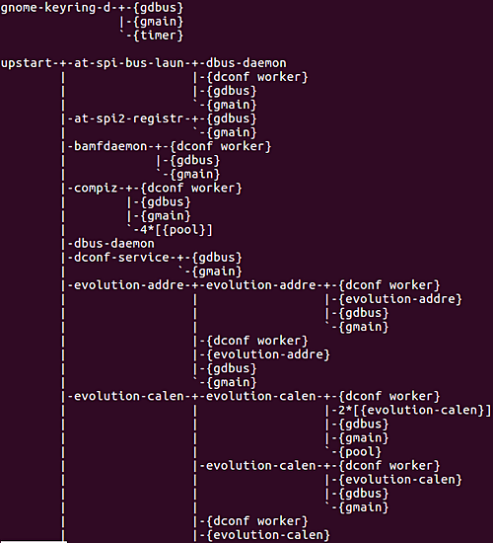
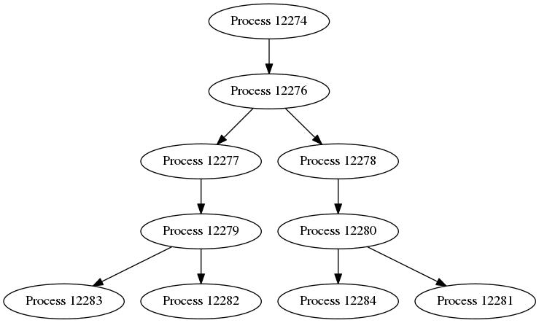
OS Multitasking: Processes as Trees
pstree in Unix
Each OS process can spawn child processes.
In turn, they may spawn child processes of their own.
Processes have their own main thread and memory.
Parents may kill their children (!)
Parents may abandon their children (!)

Slide 14
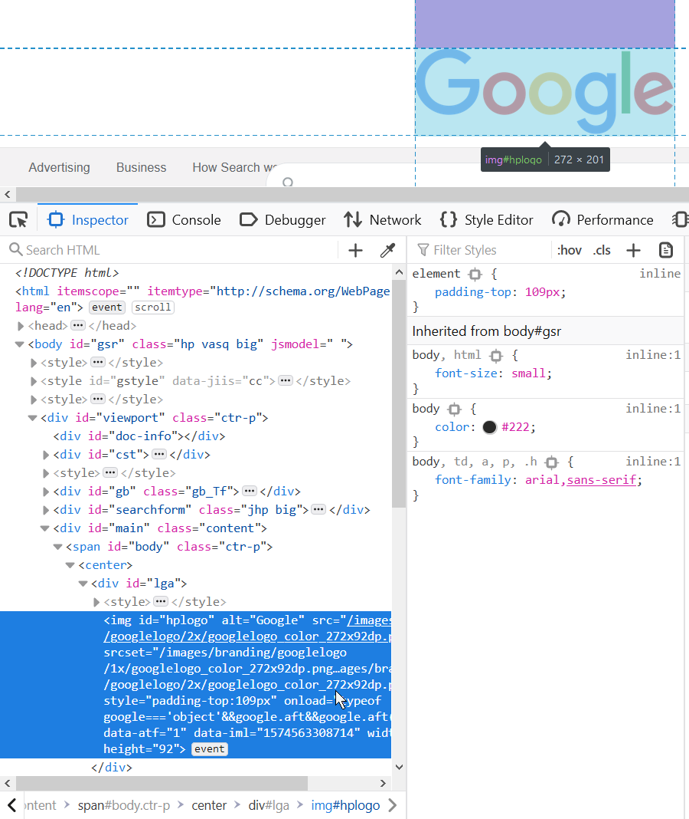
Trees as Websites
HTML (Hyper-Text Markup Language) describes the structure of webpages
Leaf nodes (text, images) provide content
Parent nodes provide context to children (styling, positioning, links)
Observe: nodes may have any number of children, to any depth
Nodes can be parents of their own type
Path to leaf gives context to leaf
Allows for reusability and extensibility, e.g. a bold link described by parent chain <b> <a>

Slide 15
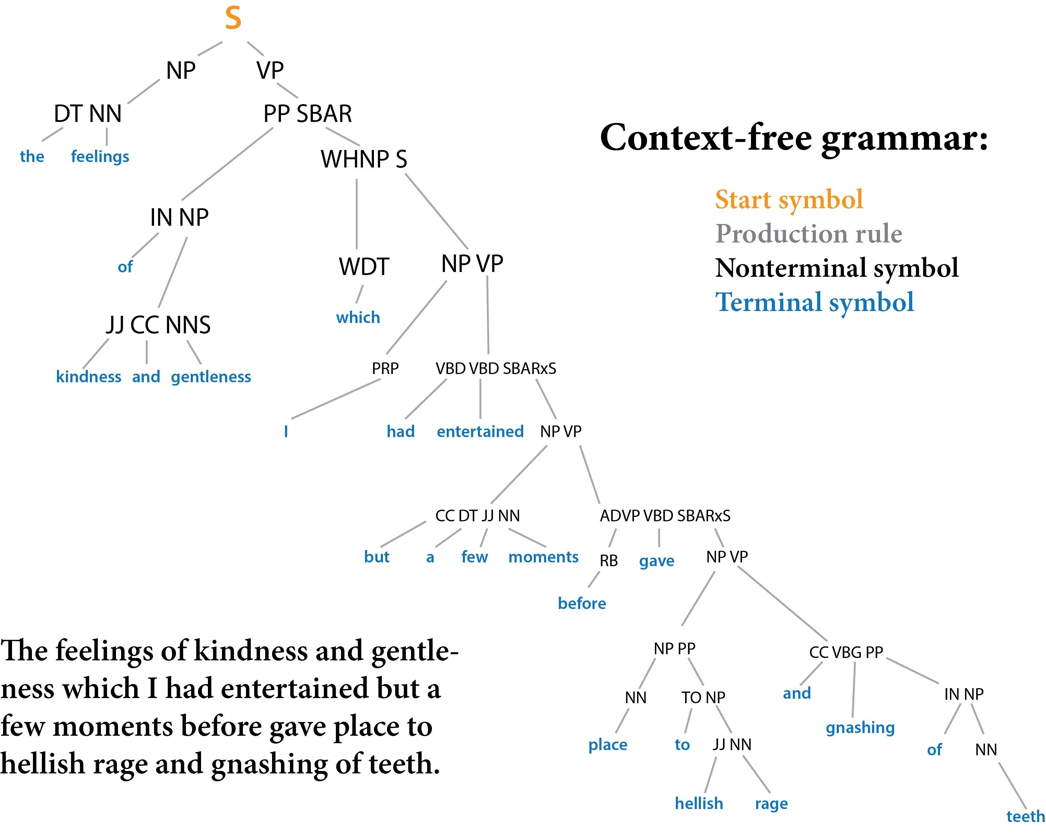
Trees as Languages
English is a Tree
Nodes are entities (subject, object, verb)
Leaves are words
English is recursive
Verb phrase can have verb phrase, …
Sentences can contain sentences?

Slide 16
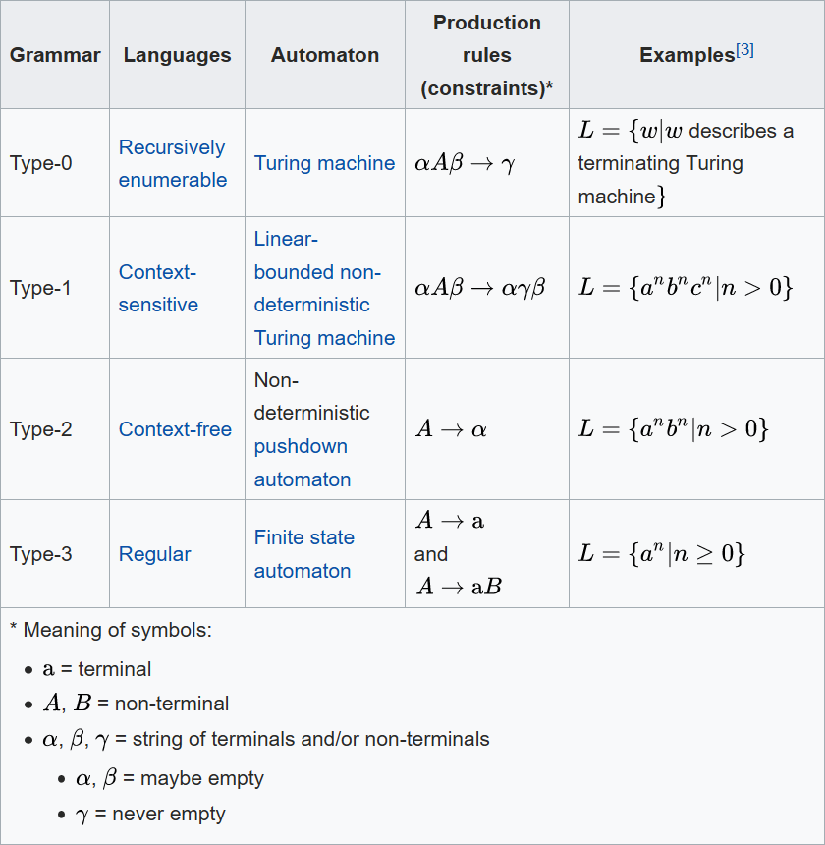
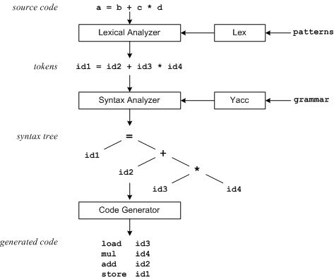
Trees as Languages
Programming Languages are Trees
Statements composed of Expressions
Expressions composed of Operators + and Operands a, b
Operands may be Statements (recursive)

Slide 17
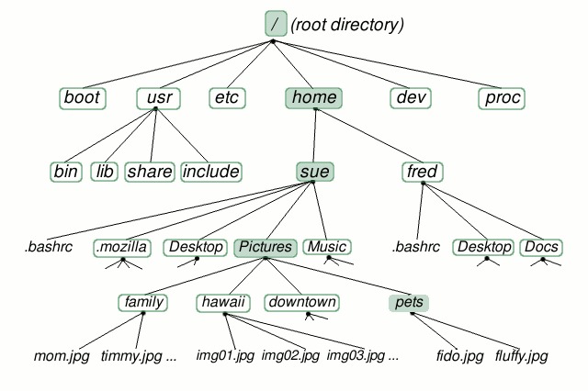
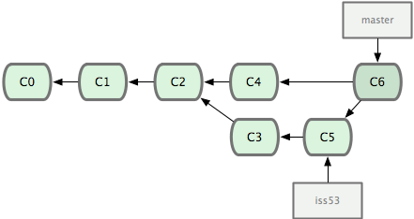
Trees as Filesystems
File Systems track directories and files
Directories are parent nodes
May also be leaf nodes
Files are leaf nodes
Git is also tree-like
Commits are nodes
Actually, a graph

Slide 18
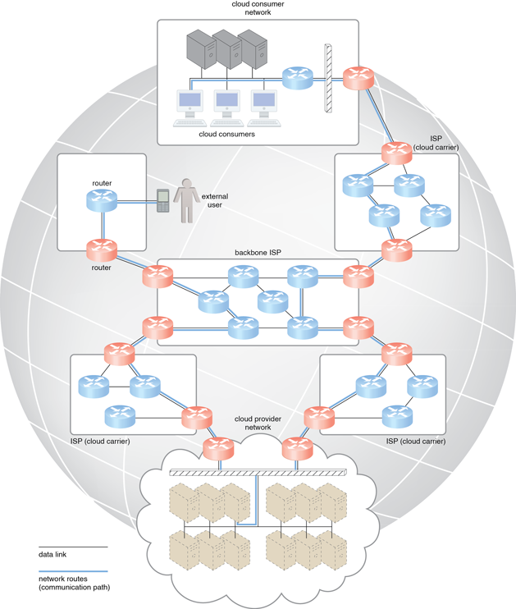
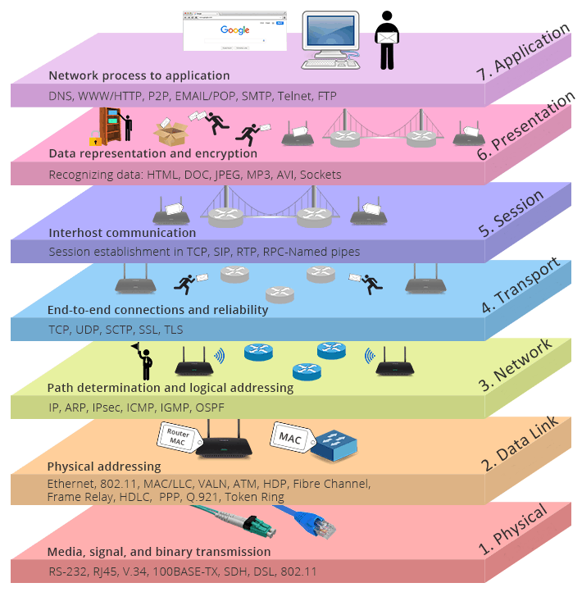
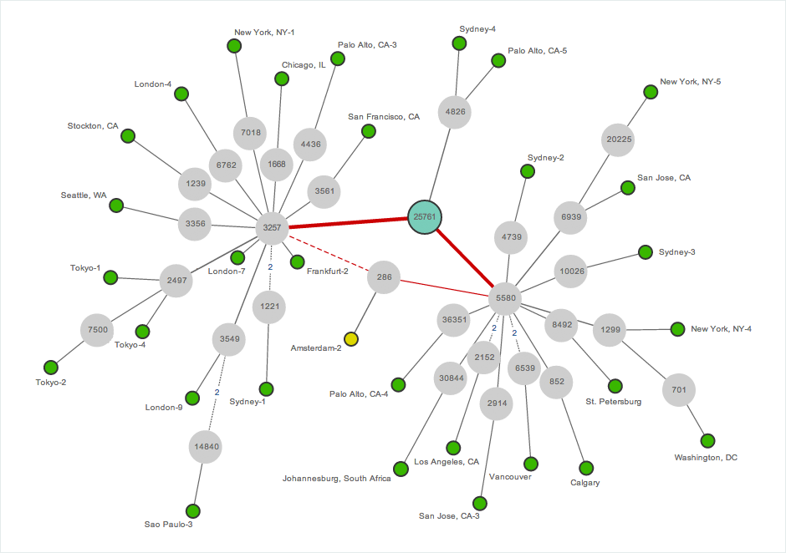
Graphs in Networking
The Internet is composed of several devices and routers
Endpoint devices (phones, laptops, etc) are like tree leaves
Middle "parent" nodes are routers that determine "one-hop" pathing

Slide 19
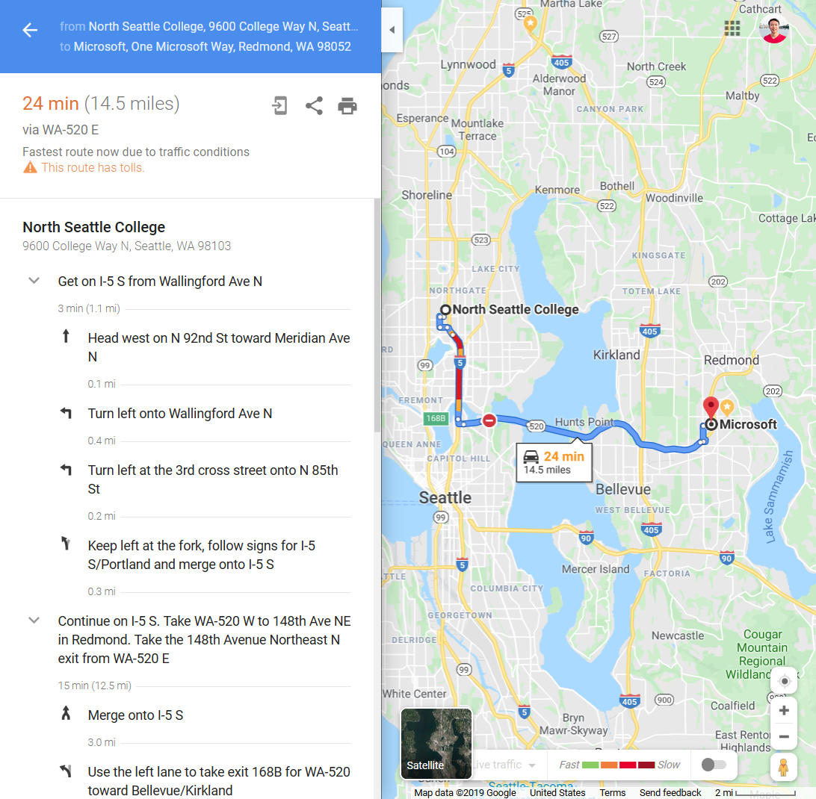
Graphs, IRL
"Airplane distance" heuristic gives extra preference towards edges in the right direction
Maps model the real world as graphs
Destinations are nodes
Streets are edges
"Cost of Travel" (time) is the cost of each edge
Dijkstra's Algorithm, plus heuristics (A*)
Heuristics penalize edges that are the wrong direction, guide pathfinding away from wasting time

Slide 20
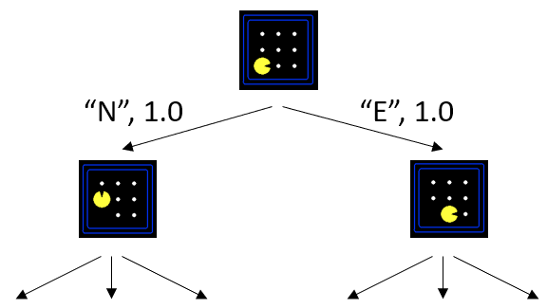
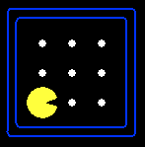
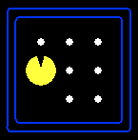
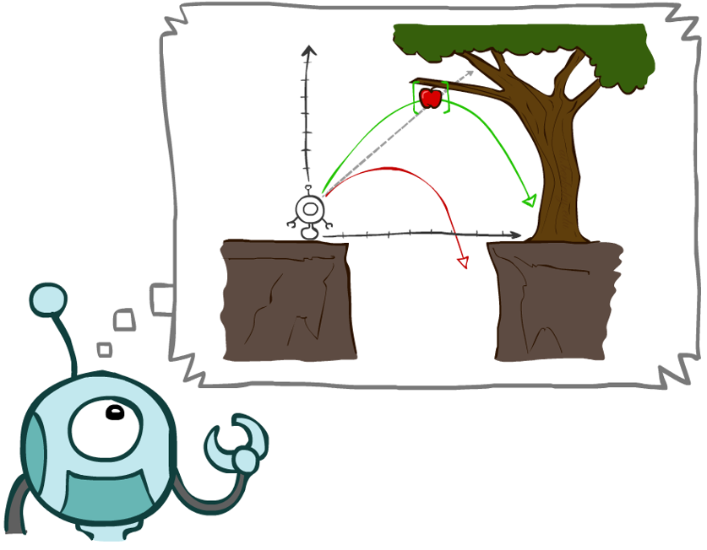
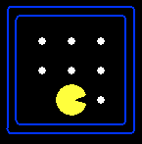
AI: State Graphs
Graphs can be used to model state and transitions for AI
State is like variables in an Object
The observed world are graph nodes
Transitions are like method invocations that change state
The actions of a robot are edges
Graph search algorithms allow robots to find paths to goals
Remember path(…)?

Slide 21


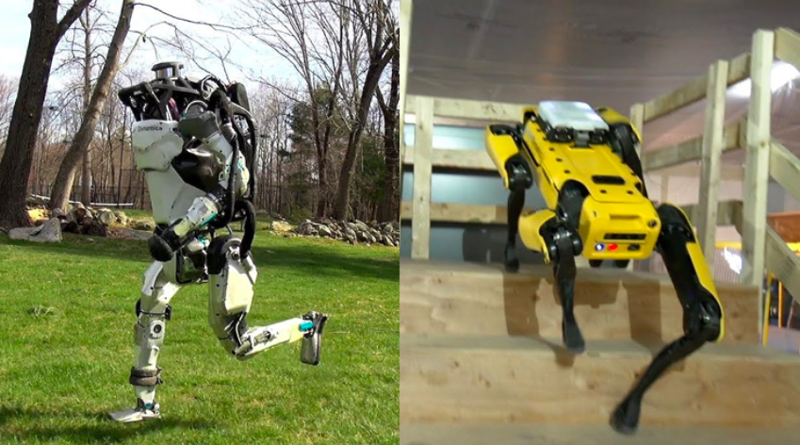
Aside: AI vs. Machine Learning (ML)
Contrary to what the media believes, AI and Machine Learning are two different things
AI: teaching computers to act rationally in a modeled world to achieve goals
ML: teaching computers to make observations about the world
Machine learning and AI can coexist, but are not synonymous!
AI
ML
AI + ML

Slide 22
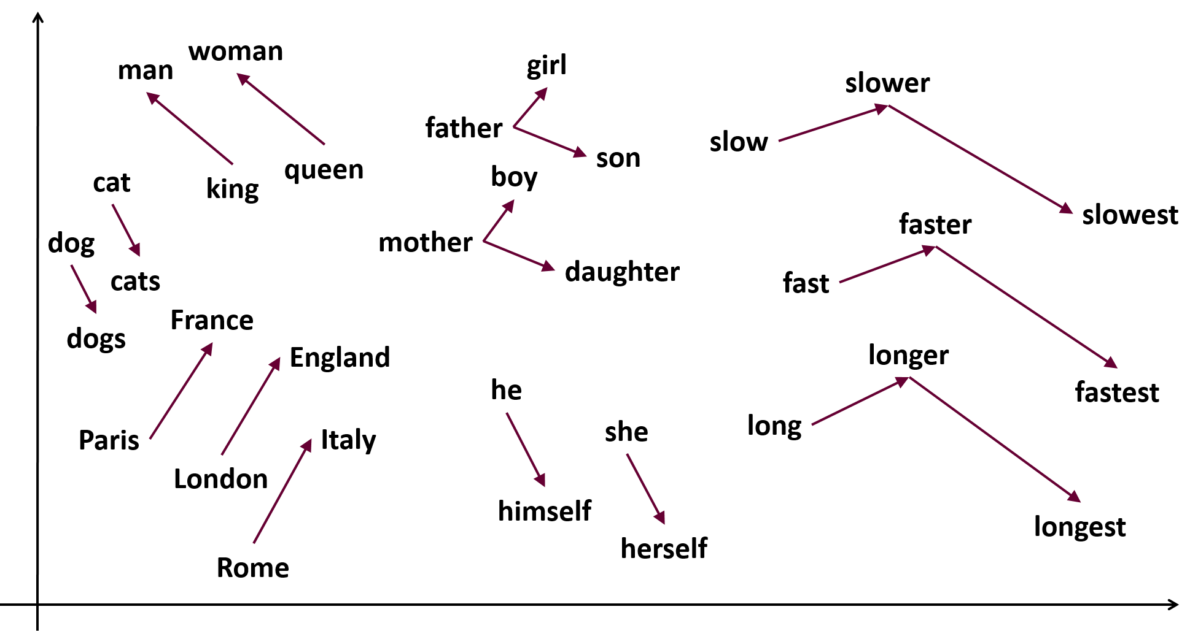

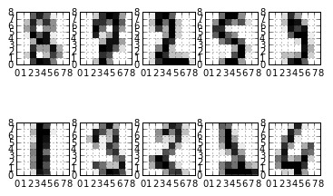
ML: Vectors & Matrices
Fundamental to ML are vectors and matrices (calculus, linear algebra)
Big Idea: model complex information as a vector or matrix of integers
Point, Point3D, arrays, 2D arrays
Position of vector and proximity to others indicate how things are related
Almost like hashing, minus the random

Slide 23
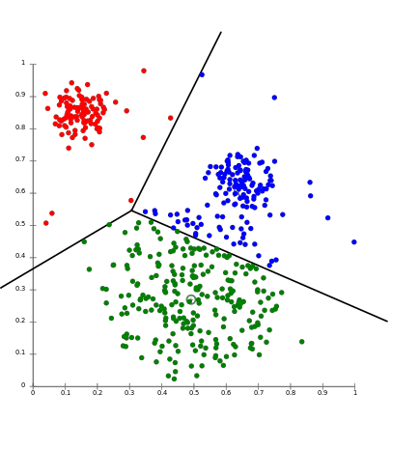
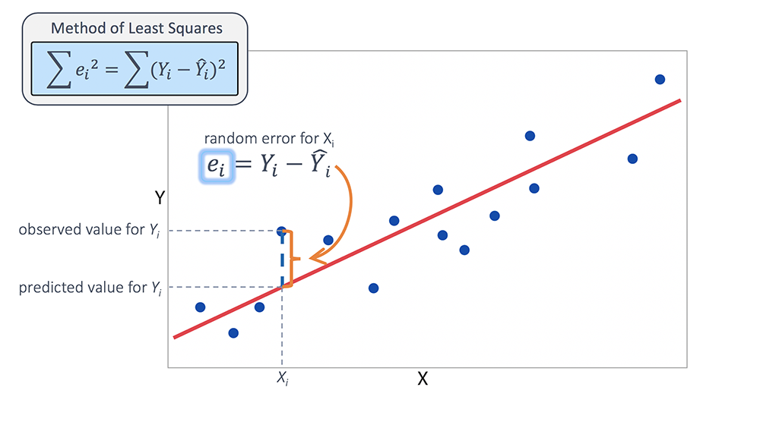
ML: Vectors & Matrices
Big Idea: model complex information as a vector or matrix of integers
Point, Point3D, arrays, 2D arrays
Position of vector and proximity to others indicate how things are related
Then: perform a regression (statistical analysis) on data

Slide 24
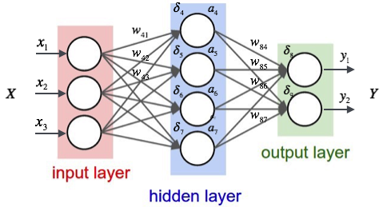
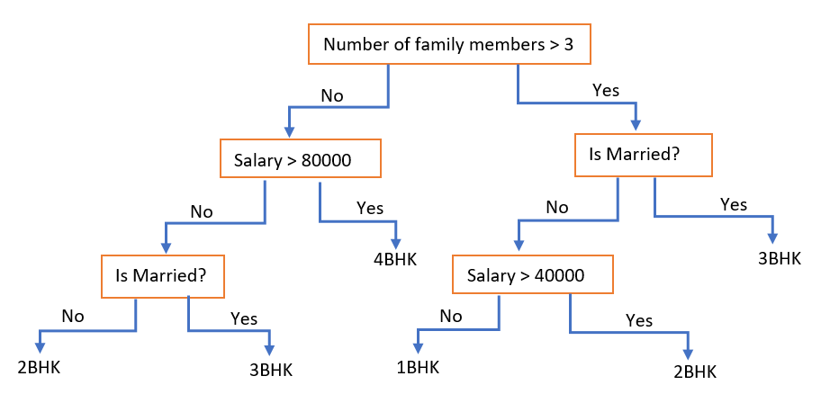
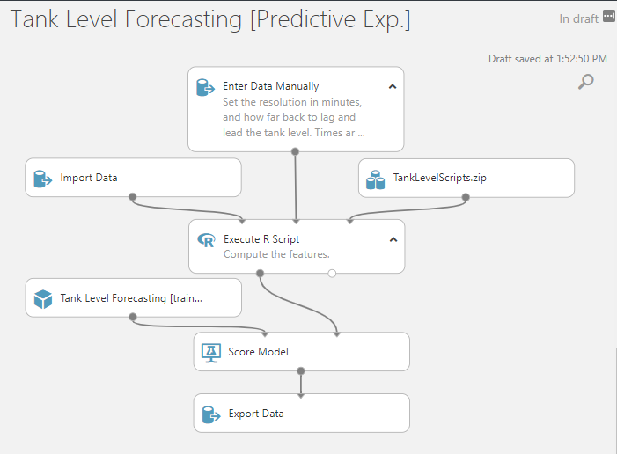
ML: Neural Nets+
Big Idea: model complex information as a vector or matrix of integers
Point, Point3D, arrays, 2D arrays
Position of vector and proximity to others indicate how things are related
Then: perform a regression (statistical analysis) on data
Neural nets (graphs) transform the data repeatedly until it becomes useful (training, gradient descent)
Decision trees find meaningful ways to divide data based on conditions

Slide 25
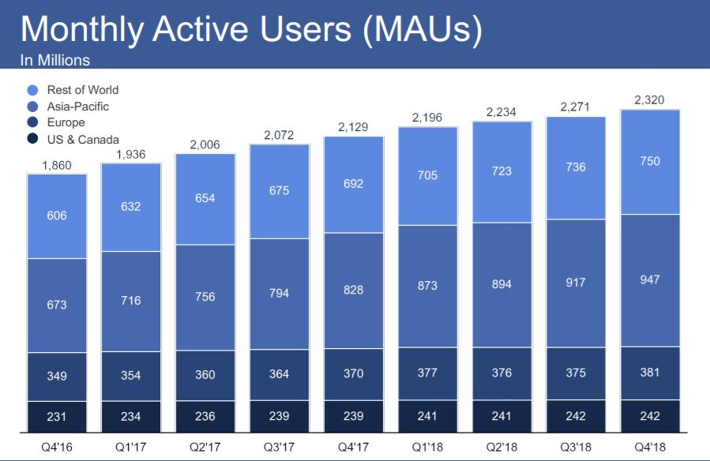
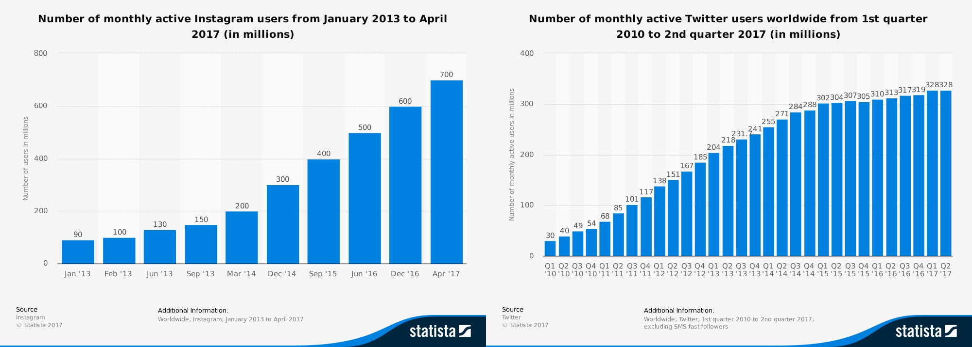
Speaking of Big Data…
Companies like Facebook track millions of users each day
Databases must associate names and information
Users expect instant response
We've seen two structures with efficient lookup
HashMap O(1)?
Binary Search Tree O(logn)?

Slide 26

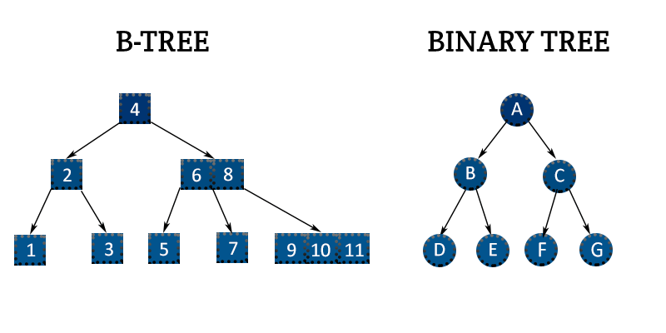
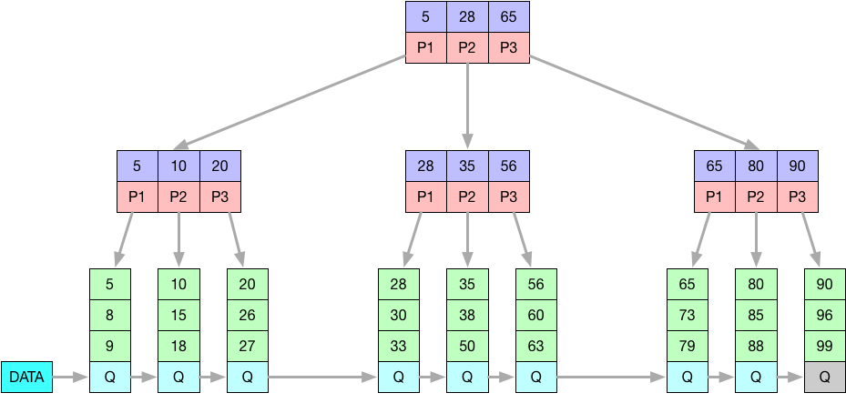
B+ Trees for Databases
Databases like MySQL use "B+ trees" for fast lookup
Like binary search trees:
left is lower, right is bigger, O(logn) lookup
Unlike binary search trees:
A node can have any number of children
B-trees are perfectly balanced (as all things sho
Why not HashMaps?
No sequential ordering (why?)
Wasted space (why?)

Slide 27

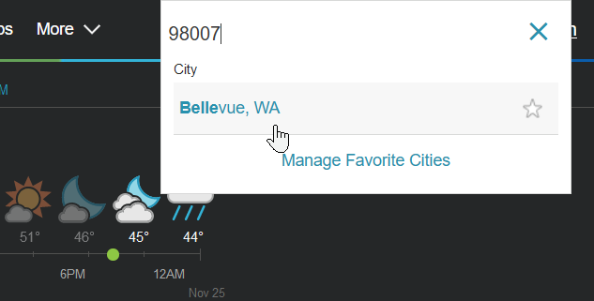
HashMap Strikes Back
Valid code in both Python and JavaScript:
map = {}
map["seattle"] = "WA"
map["portland"] = "OR"
HashMap is useful for dynamic content at "small scale"
News articles mapped to links
Zip codes mapped to cities
Videos mapped to thumbnails
Users mapped to messages
Both JavaScript and Python have HashMaps as first-class citizens of the language
Everything is a HashMap underneath
Valid code in JavaScript:
console.log("Hello, World!");
console["log"]("Hello, World!");
Valid code in Python:
def foo(): print("hello")
setattr(foo, "thing", "world")
print("hello " + getattr(foo, "thing"))

Slide 28
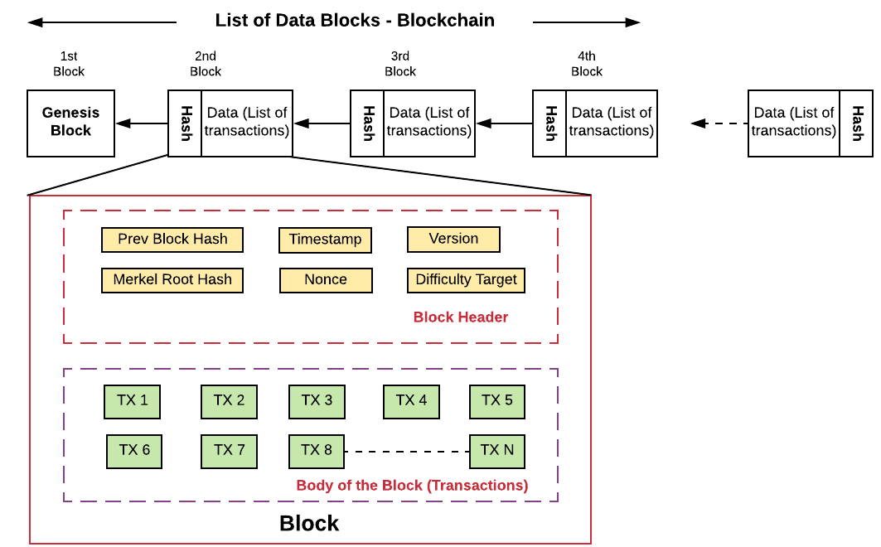

BONUS: Linked List as Blockchain?
Blockchain was all the rage of yesteryear
Linked List + hashes of neighbor blocks
Hashes "guarantee" immutability of chain

Slide 29

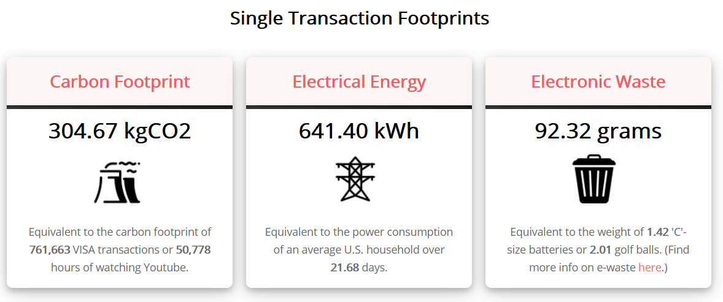
BONUS: Bitcoin – at what cost?
Blockchain was all the rage of yesteryear
Linked List + hashes of neighbor blocks
Hashes "guarantee" immutability of chain

Slide 30

The Best Data Structure?
Array (+ArrayList)
Linked List (+Doubly, Stack, Queue)
Tree (+Binary, BST)
Heap (+Priority Queue)
HashMap
Graph
bigocheatsheet.com

